Slide 1
Application of Channel Coding

Slide 2
Low Density Parity Check Code(LDPC)

Slide 3
Preliminaries
The LDPC code is a way of channel coding, which is essentially to increase communication reliability.
Hamming distance
Parity check bit
Linear block code
Tanner graph

Slide 4
Hamming distance
The Hamming distance between two bit patterns is the number of bits that are different.
For example, bit pattern 1100 and 0100 differ by one bit (the 1st bit), thus have Hamming distance of one. Two identical bit patterns have Hamming distance of zero.

Slide 5
Parity bit
A parity bit is an additional bit added to the bit pattern to make sure that the total number of 1’s is even (even parity) or odd (odd parity).
For example, the information message is 01001100 and even parity is used. Since the number of 1’s in the original message is 3, a ‘1’ is added at the end to give the transmitted message of 010011001.
The decoder counts the number of 1’s (normally done by exclusive OR the bit stream) to determine if an error has occurred.

Slide 6
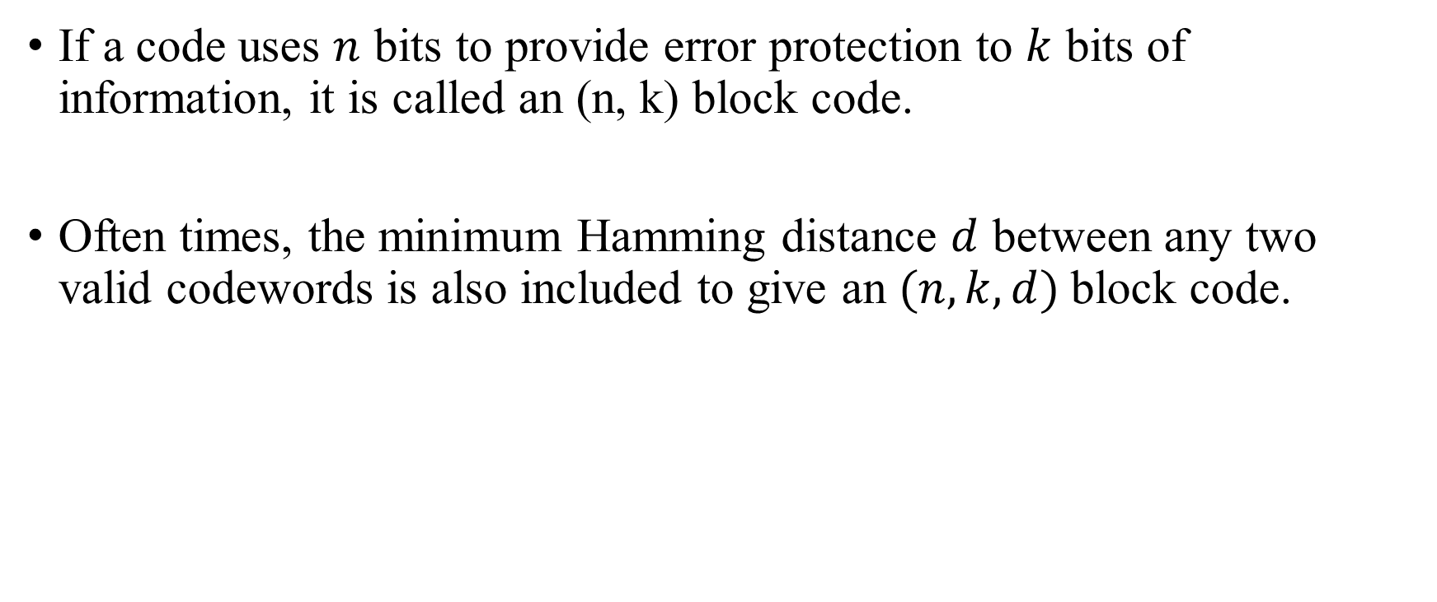
Linear block code
If a code uses $n$ bits to provide error protection to $k$ bits of information, it is called an (n, k) block code.
Often times, the minimum Hamming distance $d$ between any two valid codewords is also included to give an $(n, k, d)$block code.

Slide 7
An example of block codes is Hamming code.
Consider the scenario where we wish to correct single error using the fewest number of parity bits (highest code rate). Each parity bit gives the decoder a parity equation to validate the received code.
With 3 parity bits, we have 3 parity equations, which can identify up to 2³ = 8 error conditions. One condition identifies “no error”, so seven would be left to identify up to seven places of single error. Therefore, we can detect and correct any single error in a 7-bit word. With 3 parity bits, we have 4 bits left for information. Thus this is a (7, 4) hamming code.

Slide 8
In a (7, 4) Hamming code, the parity equations use the binary representation of the location of the error bit. For example, location 5 has the binary representation of 101, thus appears in equation 1 and 3.
By applying this rule, we can tell which bit is wrong by reading the value of the binary combination of the result of the parity equations, with 1 being incorrect and 0 being correct. For example, if equation 1 and 2 are incorrect and equation 3 is correct, we can tell that the bit at location 6 (110) is wrong.

Slide 9
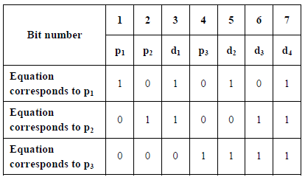
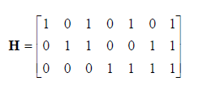
At the encoder, if location 3, 5, 6, 7 contain the original information and location 1, 2, 4 contain the parity bits (locations which are power of 2).
(7, 4) Hamming code can be summarized in the following Table 1, where p denotes parity bits, d denotes data bits. The right side of Table 1 is the corresponding parity-check matrix.

Slide 10
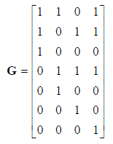
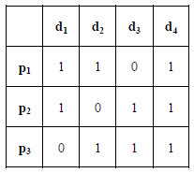
Removing the parity bits, we have table 2, the right side of Table 2 is the corresponding generator matrix.

Slide 11
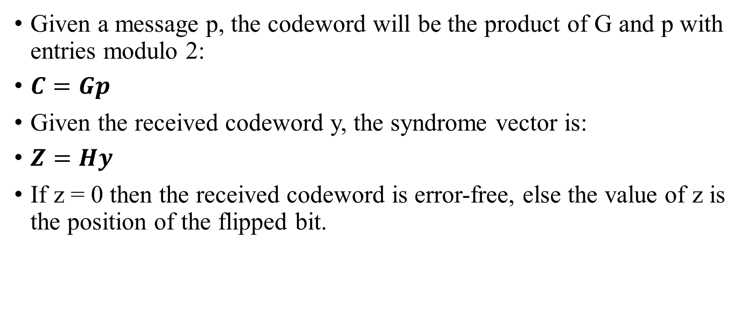
Given a message p, the codeword will be the product of G and p with entries modulo 2:
$C=Gp$
Given the received codeword y, the syndrome vector is:
$Z=Hy$
If z = 0 then the received codeword is error-free, else the value of z is the position of the flipped bit.

Slide 12

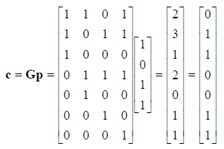
For example
If the message is
then the codeword will be

Slide 13
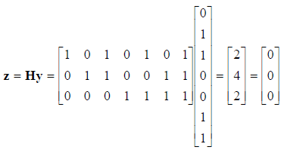
If no bit is flipped during transmission, in other words, y = c. Then the syndrome vector is

Slide 14

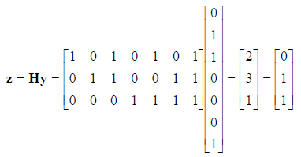
If the 6th bit is flipped,
Reading z from the bottom up (higher position first), we see the flipped bit is indeed 6 (110).

Slide 15
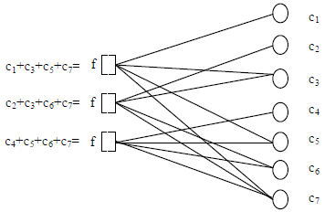
Tanner graph
A very useful way of representing linear block codes is using Tanner graph. Tanner graph is a bipartite graph, which means the graph is separated into two partitions: message nodes and check nodes, connection between nodes indicates association.

Slide 16
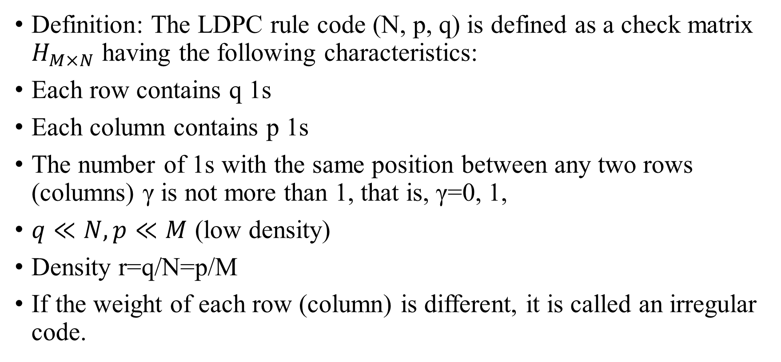
LDPC(low-density parity-check code)
Definition: The LDPC rule code (N, p, q) is defined as a check matrix $H_{M×N}$ having the following characteristics:
Each row contains q 1s
Each column contains p 1s
The number of 1s with the same position between any two rows (columns) γ is not more than 1, that is, γ=0, 1,
$q≪N,p≪M$ (low density)
Density r=q/N=p/M
If the weight of each row (column) is different, it is called an irregular code.

Slide 17
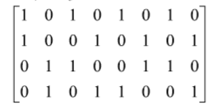
LDPC(low-density parity-check code)
H=
An example of parity check matrix of LDPC

Slide 18
Decoding of LDPC
There are two derivations of this decoding algorithm: hard-decision and soft-decision schemes. Today I only talk about hard-decision. You can learn soft-decision by yourself. Then, we uses a (4, 8) linear block code to illustrate the hard-decision decoder.

Slide 19
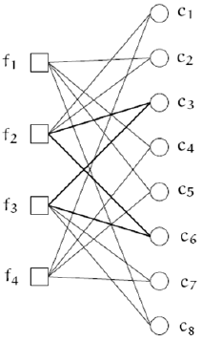
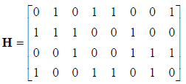
Hard-decision Decoder
The code is shown on the left and above is its corresponding parity-check matrix.

Slide 20
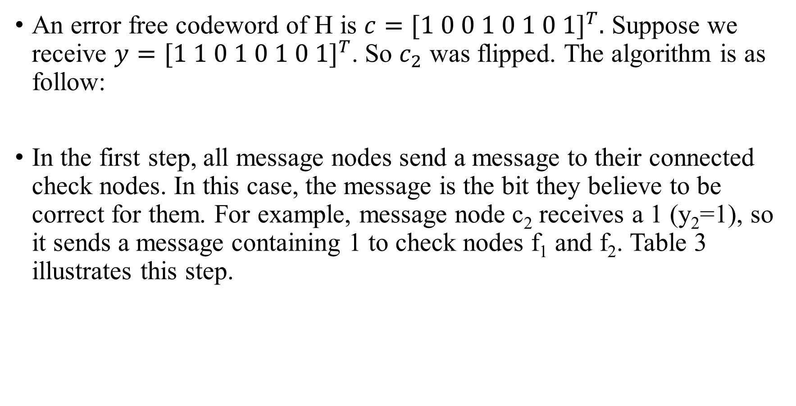
An error free codeword of H is $c={[1 0 0 1 0 1 0 1]}^{T}.$ Suppose we receive $y={[1 1 0 1 0 1 0 1]}^{T}$. So $c_{2}$ was flipped. The algorithm is as follow:
In the first step, all message nodes send a message to their connected check nodes. In this case, the message is the bit they believe to be correct for them. For example, message node c₂ receives a 1 (y₂=1), so it sends a message containing 1 to check nodes f₁ and f₂. Table 3 illustrates this step.

Slide 21
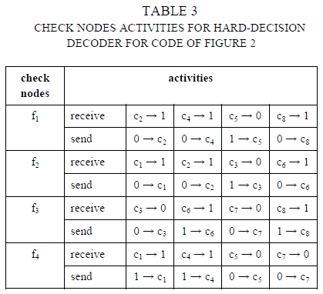
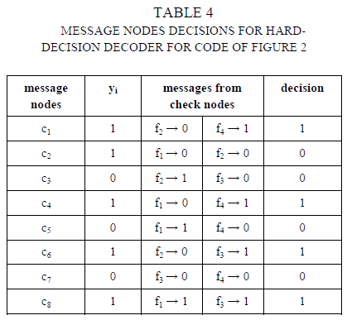

Slide 22
In the second step, every check nodes calculate a response to their connected message nodes using the messages they receive from step 1. The response message in this case is the value (0 or 1) that the check node believes the message node has based on the information of other message nodes connected to that check node. This response is calculated using the parity-check equations which force all message nodes connect to a particular check node to sum to 0 (mod 2).
In Table 3, check node f₁ receives 1 from c₄, 0 from c₅, 1 from c₈ thus it believes c₂ has 0 (1+0+1+0=0), and sends that information back to c₂. Similarly, it receives 1 from c₂, 1 from c₄, 1 from c₈ thus it believes c₅ has 1 (1+1+1+1=0), and sends 1 back to c₅.
At this point, if all the equations at all check nodes are satisfied, meaning the values that the check nodes calculate match the values they receive, the algorithm terminates. If not, we move on to step 3.

Slide 23
In the third step, the message nodes use the messages they get from the check nodes to decide if the bit at their position is a 0 or a 1 by majority rule. The message nodes then send this hard-decision to their connected check nodes. Table 4 illustrates this step. To make it clear, let us look at message node c₂. It receives 2 0’s from check nodes f₁ and f₂. Together with what it already has y₂ = 1, it decides that its real value is 0. It then sends this information back to check nodes f₁ and f₂.
In the last step, repeat step 2 until either exit at step 2 or a certain number of iterations has been passed.
In this example, the algorithm terminates right after the first iteration as all parity-check equations have been satisfied. c₂ is corrected to 0.

